Slide 2
THE DISCIPLES RELATIONSHIP:
TO HIMSELF
An Athlete
A Soldier
TO HIS LORD
The Potter and the Clay
The Vine and the Branches
A Child of God
TO HIS BRETHREN
A Member of the Body
“My Brother’s Keeper”
A Servant
TO THE WORLD
Strangers & Pilgrims
Salt & Light
An Apologist
Fishers of Men

Slide 3
LESSON 2: An Athlete The Disciples Commitment
Do you not know that those who run in a race all run, but only one receives the prize? Run in such a way that you may win. (1 Corinthians 9:24)

Slide 4
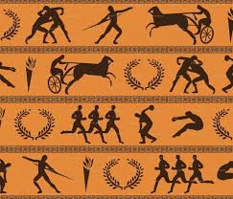
Commitment
Before you commit, you count the cost. (Luke 14:28)
Once you commit, you don’t look back (Luke 9:62)
Greek/Roman Games:
Isthmian
Olympic
Nemean
Pythian

Slide 5
Exercise towards Godliness
Praying
Obeying the Truth
Learning and Defending the Word
Spreading the Gospel
Helping other Christians
Willing to Suffer
Finishing the Course
Striving
Contending
Running
Practice
Exercise
Wrestling together
Running in Vain
Fighting/Combat

Slide 6
The Athlete’s Commitment
Rigorous Training
Competing by the Rules
Running to Win

Slide 7
The Athlete’s Commitment
1. Rigorous Training
Matt. 5:29-30; Gal. 2:20; 1Tim. 4:7-8
2. Competing by the Rules
3. Running to Win
“Do you not know that those who run in a race all run, but only one receives the prize? Run in such a way that you may win. Everyone who competes in the games exercises self-control in all things. They then do it to receive a perishable wreath, but we an imperishable. Therefore I run in such a way, as not without aim; I box in such a way, as not beating the air; but I discipline my body and make it my slave, so that, after I have preached to others, I myself will not be disqualified.” (1Cor. 9:24-27)

Slide 8
The Athlete’s Commitment
1. Rigorous Training
2. Competing by the Rules
2Tim. 2:5; Luke 14:26-27
3. Running to Win
“Do you not know that those who run in a race all run, but only one receives the prize? Run in such a way that you may win. Everyone who competes in the games exercises self-control in all things. They then do it to receive a perishable wreath, but we an imperishable. Therefore I run in such a way, as not without aim; I box in such a way, as not beating the air; but I discipline my body and make it my slave, so that, after I have preached to others, I myself will not be disqualified.” (1Cor. 9:24-27)

Slide 9
The Athlete’s Commitment
1. Rigorous Training
2. Competing by the Rules
3. Running to Win
Heb. 12:1-2; Col. 3:1-2; Phil. 3:12-14; 2Tim. 4:7-8
“Do you not know that those who run in a race all run, but only one receives the prize? Run in such a way that you may win. Everyone who competes in the games exercises self-control in all things. They then do it to receive a perishable wreath, but we an imperishable. Therefore I run in such a way, as not without aim; I box in such a way, as not beating the air; but I discipline my body and make it my slave, so that, after I have preached to others, I myself will not be disqualified.” (1Cor. 9:24-27)

Slide 10
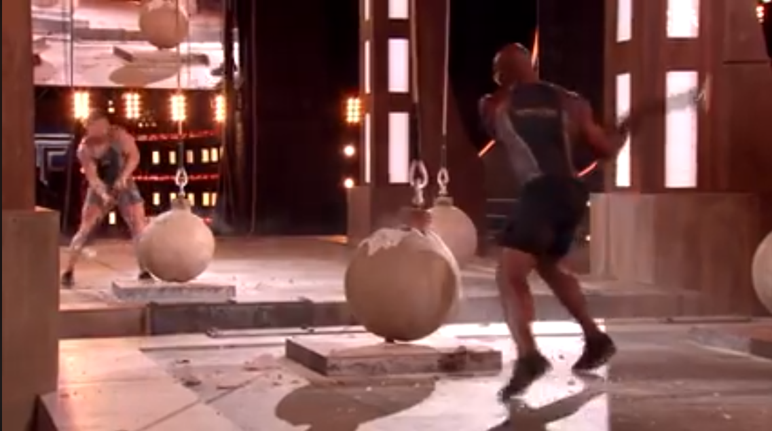
The Athlete’s Commitment
Rigorous Training
Competing by the Rules
Running to Win

Slide 11
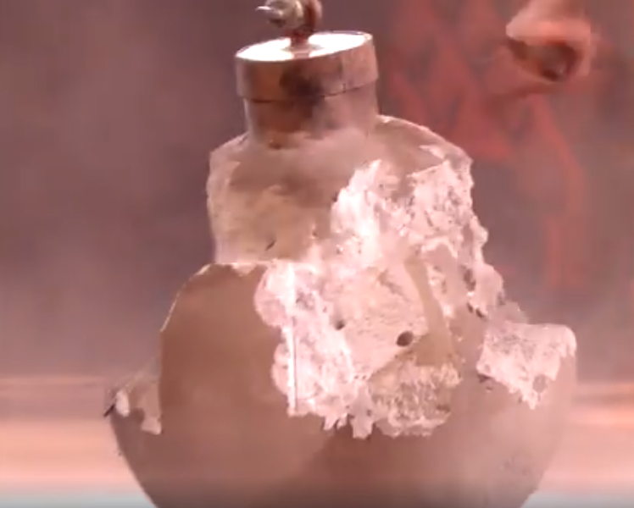
The Athlete’s Commitment
Rigorous Training
Competing by the Rules
Running to Win

Slide 12
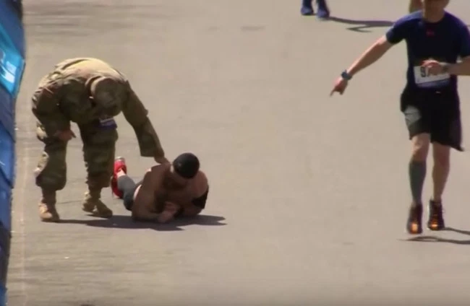
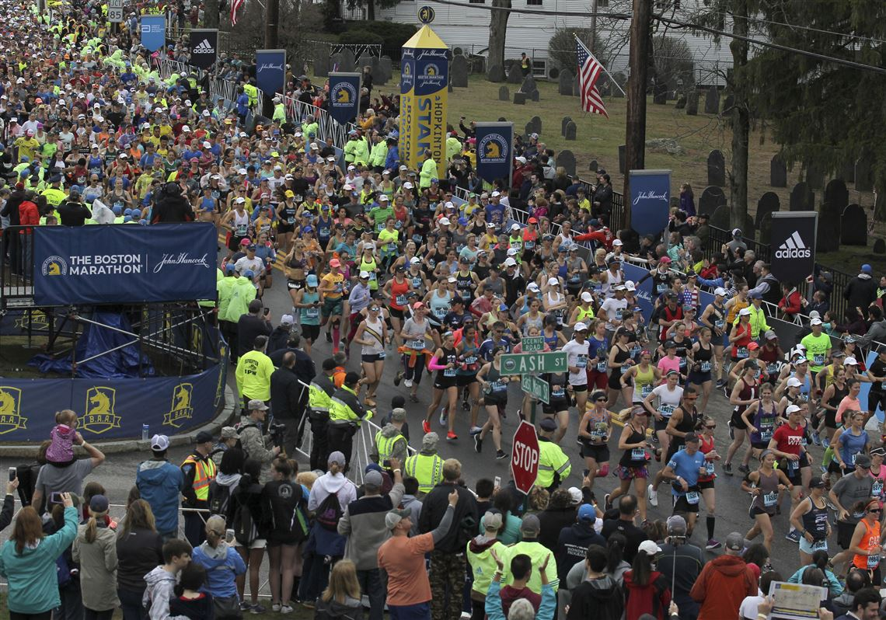
The Athlete’s Commitment
Rigorous Training
Competing by the Rules
Running to Win

Slide 13
The Athlete’s Commitment
Rigorous Training
Competing by the Rules
Running to Win
Applied to our Spiritual Life:
Obedience
Prayer
Spreading the gospel
Serving others

Slide 14
Discipleship this week
Who or what are you praying earnestly about?
What exercises are you doing? What habits are you going to create? Is your training challenging enough?
Are you training with purpose? What do you think about most often? Where is your mind set?
Are you doing everything you can to maintain self-control and keep yourself under subjection? How are you helping others?

